Slide 1
Confidence Intervals for Proportions
Week 3 Lecture 3

Slide 2
Let’s put things together
Investigation 2 – Last 4 - 5 questions
Central Limit Theorem for Sample Proportion
They lead us to talk about more “nicely shaped” distributions
Unimodal that are not too skewed and tails are not overly long or short
Normal Distribution

Slide 3
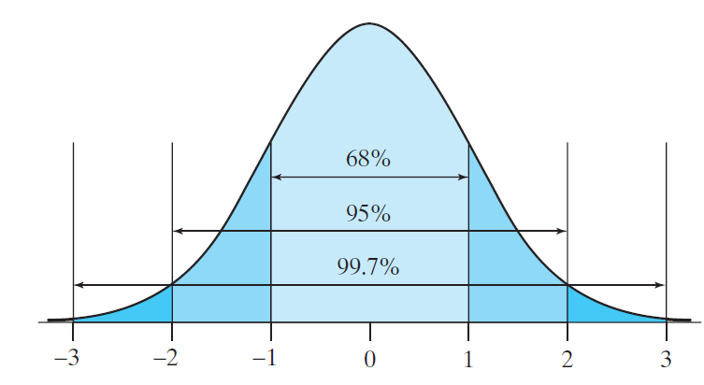
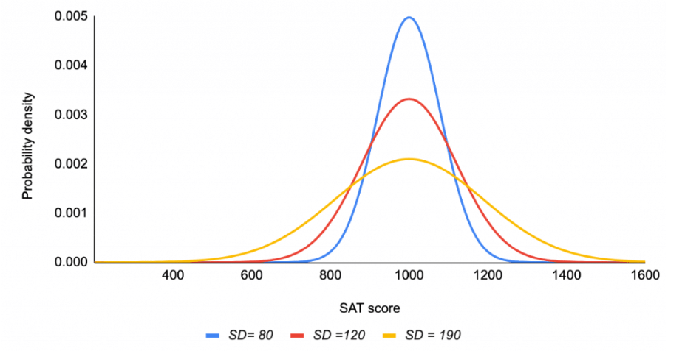
Normal Distribution
The distribution of many real-world phenomena follow a normal distribution.
Empirical Rule (68-95-99.7% rule): In a Normal distribution, we expect to find
about 68% of data within ± 1 SD of the mean.
about 95% of data within ± 2 SDs of the mean.
>99% of data within ± 3 SDs of the mean.

Slide 4
Review of Central Limit Theorem for Sample Proportion

Slide 5
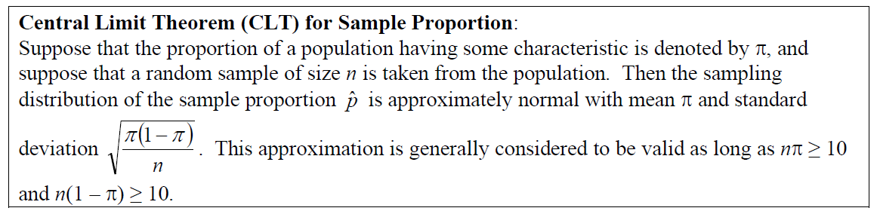
REMEMBER!
The values of statistics vary from sample to sample.
This phenomenon is called sampling variability.
Fortunately, if we look at the results of many samples, there is a predictable pattern to this variability.
This pattern is called the sampling distribution of the statistic.

Slide 6
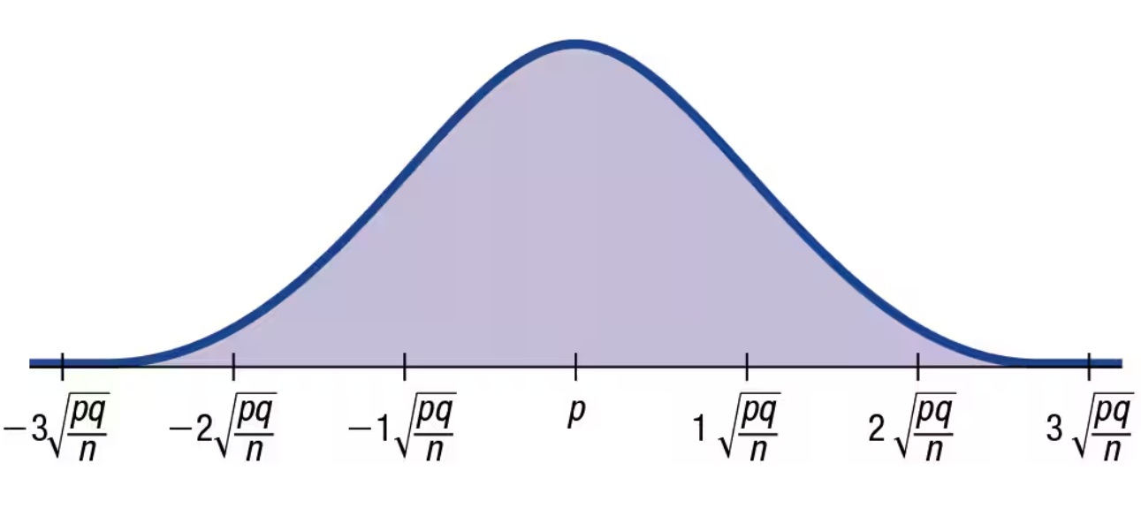

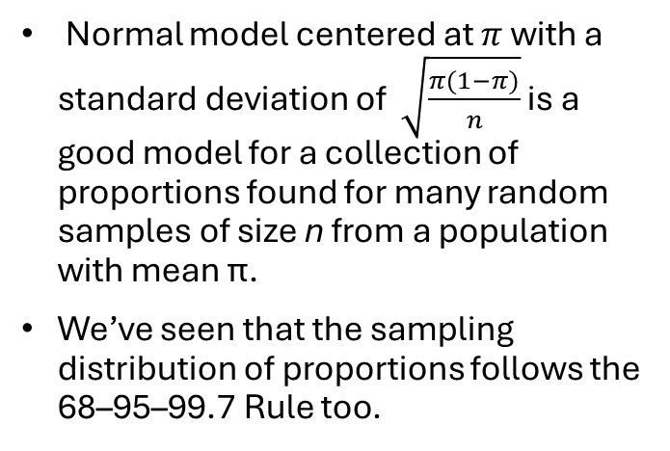
Sampling Distribution of the Sample Proportion
Normal model centered at $π$ with a standard deviation of $\sqrt{\frac{π(1−π)}{n}}$ is a good model for a collection of proportions found for many random samples of size n from a population with mean π.
We’ve seen that the sampling distribution of proportions follows the 68–95–99.7 Rule too.
$$π$$
$$π$$

Slide 7
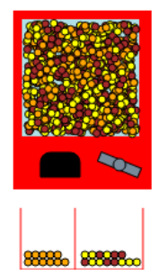
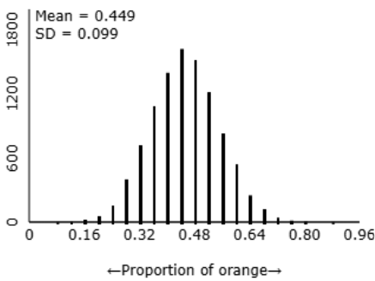
Central Limit Theorem for Sample Proportion
Even though we can’t control sampling variability, we can predict exactly how much different proportions will vary from sample to sample.
This will enable us to make sound decisions based on a single sample.
After all, in real life, you will not take 10,000 samples, right?

Slide 8
Confidence Intervals for a Single Proportion

Slide 9
Confidence Interval for Proportions
Much of Statistics involves making inferences about parameters based on statistics.
With categorical variables, the simplest relevant parameter/statistic is a proportion.
Two primary kinds of statistical inference procedures are:
Parameter estimation, which estimate the value of a population parameter with a value or an interval of values based on a sample statistic;
Point Estimation
Interval Estimation
Hypothesis Testing: Next week…

Slide 10
Gallup Example
EXAMPLE: The Gallup Poll periodically asks a random sample of U.S. adults whether they think economic conditions are getting better, getting worse, or staying about the same. When Gallup polled 3559 respondents in April 2013 (during the week ending April 21), only 1495 thought economic conditions in the United States were getting better—a sample proportion of 0.42.

Slide 11
Gallup Example
What can we say about consumer confidence in the entire population when the proportion that we measure keeps bouncing around from sample to sample?
That’s where the sampling distribution model can help.

Slide 12
Here is what we know
What do we know about our sampling distribution model?
It’s centered at the true proportion, $π$, of all U.S. adults who think the economy is improving.
But we don’t know $π$ .
It probably isn’t 42.0%.
That’s the statistic (p-hat) from our sample.
The standard deviation of the sampling distribution is $\sqrt{\frac{π(1−π)}{n}}$.
The shape of the sampling distribution is approximately Normal, when the sample is large enough.

Slide 13
Is what we know useful?
This is all fine in the model world, but we need to solve problems in the real world.
In the real world, we don’t know $π$.
If we did, we wouldn’t have bothered to take a sample.
And so, we don’t know $\sqrt{\frac{π(1−π)}{n}}$ either.
But, we’ll do the best we can and estimate it by using $\sqrt{\frac{\hat{p}(1−\hat{p})}{n}}$ .

Slide 14
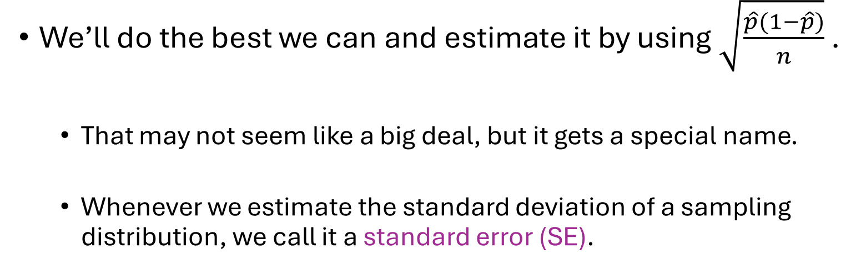
Is what we know useful? – Gallup Example
We’ll do the best we can and estimate it by using $\sqrt{\frac{\hat{p}(1−\hat{p})}{n}}$ .
That may not seem like a big deal, but it gets a special name.
Whenever we estimate the standard deviation of a sampling distribution, we call it a standard error (SE).

Slide 15
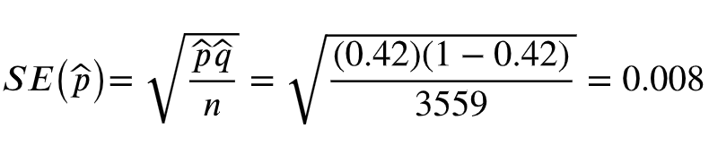

Gallup Example (Still!)
Using $\hat{p}$we find the standard error
$$\sqrt{\frac{\hat{p}(1−\hat{p})}{n}}$$

Slide 16
What is Confidence Interval?
Because the sampling distribution is Normal, we expect that about
68% of all samples of 3559 U.S. adults would have sample proportions within 1 standard deviation of $π$.
95% of all these samples will have proportions within $π$± 2SEs.
But where is our sample proportion in this picture? And what value does $π$ really have?
We still don’t know!
We know that for 95% of random samples, $\hat{p}$will be no more than 2 SEs away from $π$.

Slide 17
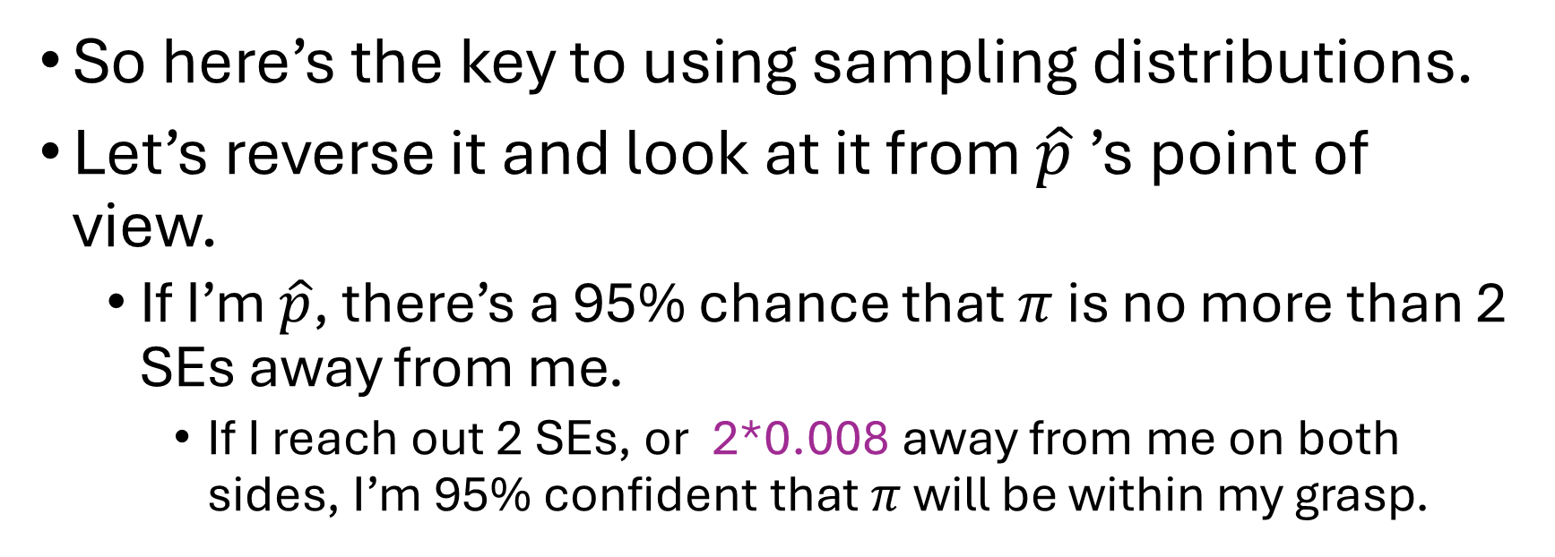
What is Confidence Interval?
So here’s the key to using sampling distributions.
Let’s reverse it and look at it from $\hat{p}$’s point of view.
If I’m $\hat{p}$, there’s a 95% chance that $π$ is no more than 2 SEs away from me.
If I reach out 2 SEs, or 2*0.008 away from me on both sides, I’m 95% confident that $π$ will be within my grasp.

Slide 18
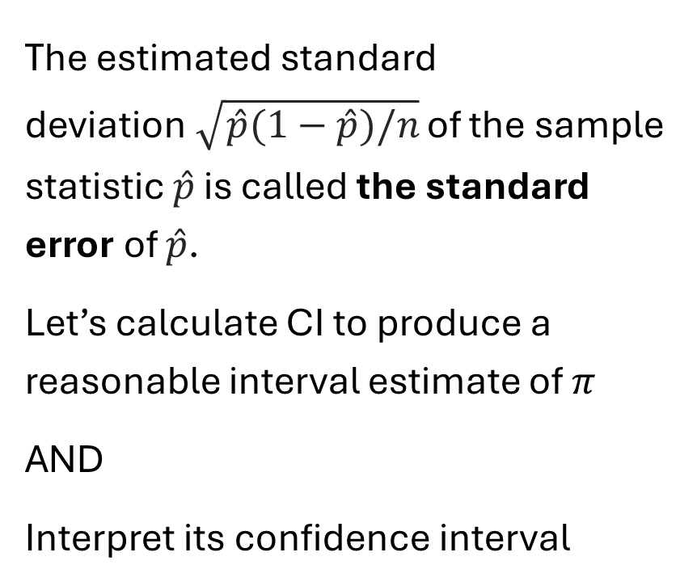
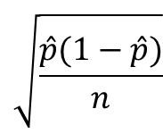
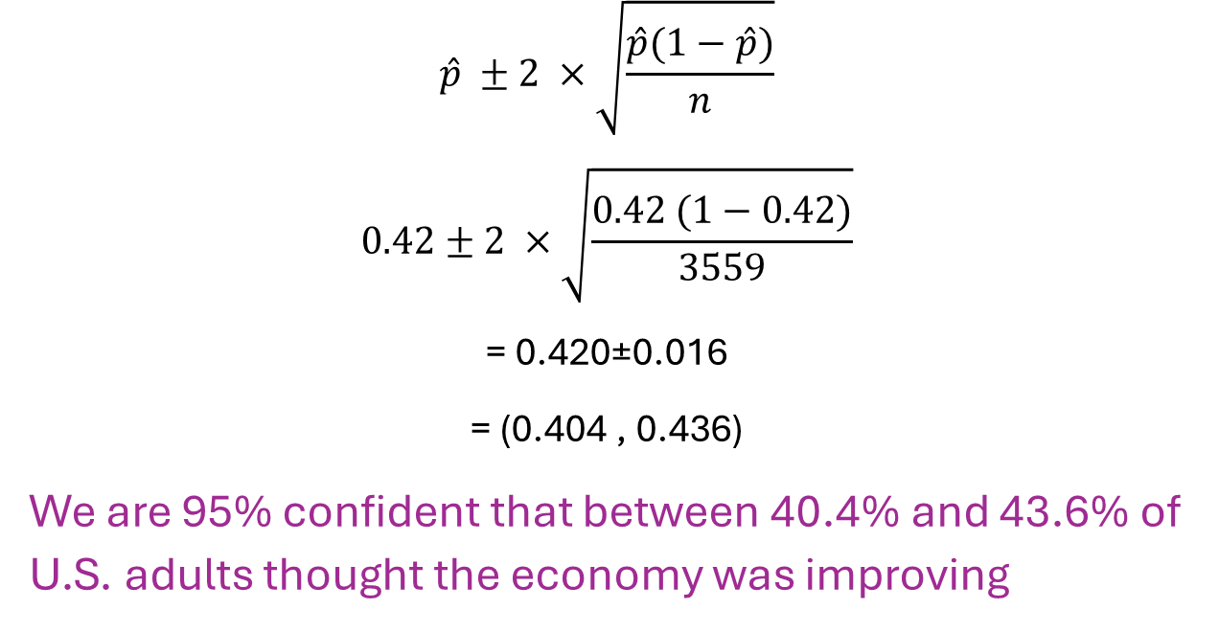
Confidence Interval for Proportions
The estimated standard deviation$\sqrt{\hat{p}(1−\hat{p})/n}$ of the sample statistic $\hat{p}$ is called the standard error of $\hat{p}$.
Let’s calculate CI to produce a reasonable interval estimate of $π$
AND
Interpret its confidence interval
$$\sqrt{\frac{\hat{p}(1−\hat{p})}{n}}$$
$$\hat{p} ±2 ×\sqrt{\frac{\hat{p}(1−\hat{p})}{n}}$$
$$0.42±2 ×\sqrt{\frac{0.42 (1−0.42)}{3559}}$$
= 0.420±0.016
= (0.404 , 0.436)
We are 95% confident that between 40.4% and 43.6% of U.S. adults thought the economy was improving

Slide 19
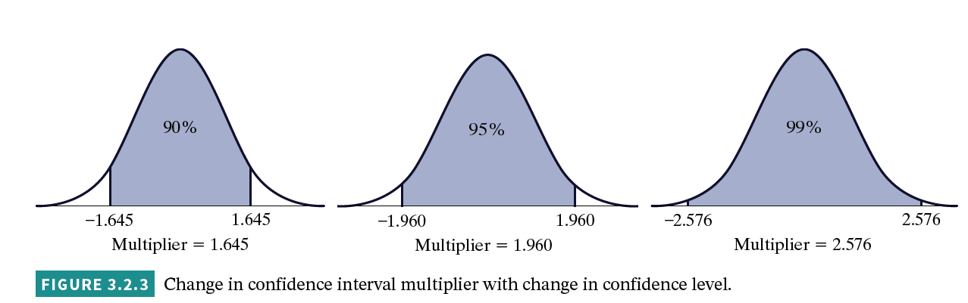
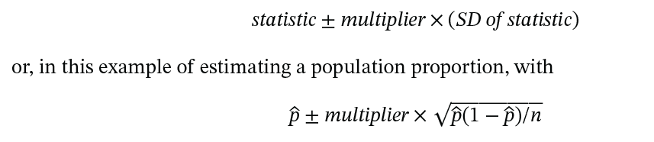
Confidence Interval for Proportions
The multiplier 2 is just an approximation.
A general formula template for CI
To produce a confidence interval for the population proportion π

Slide 20
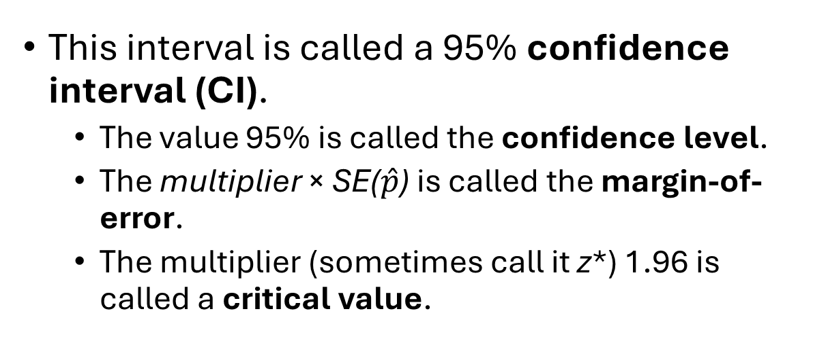
Confidence Interval for Proportions
This interval is called a 95% confidence interval (CI).
The value 95% is called the confidence level.
The multiplier × SE($\hat{p}$) is called the margin-of-error.
The multiplier (sometimes call it z*) 1.96 is called a critical value.

Slide 21
Technical Conditions for Validity of This Procedure
Simple random sample from population of interest
n × $\hat{p}$≥ 10 and n × (1 – $\hat{p}$) ≥ 10
The midpoint of this interval is the sample proportion $\hat{p}$.
The width of this interval is the difference in the endpoints.
Margin-of-error is the half-width of the interval.
The margin-of-error depends on three factors:
confidence level, which determines z*
sample size n
sample proportion $\hat{p}$ (to a lesser extent)
Values of z* for some common confidence levels are:
Applet: Theory-Based Inference
Confidence level | 80% | 90% | 95% | 99% | 99.9%
Critical value z* | 1.282 | 1.645 | 1.960 | 2.576 | 3.291

Slide 22
Confidence Interval Statement
Incorrect Statement: 42.0% of all U.S. adults thought the economy was improving.
Correct Statement: “We are 95% confident that between 40.4% and 43.6% of U.S. adults thought the economy was improving.”
Statements like this are called confidence intervals. They don’t tell us everything we might want to know, but they’re the best we can do.

Slide 23

Confidence Interval Simulation
Reese’s Pieces® candies come in three colors: orange, yellow, and brown. Suppose that you take a random sample of candies and want to estimate the long-run proportion of candies that is orange.
Let’s assume for now (although we would not know this when conducting the study) that this long-run proportion, symbolized by π, is equal to 0.45.

Slide 24
Reese’s Pieces - 3 Questions
Suppose that you take a random sample of 100 Reese’s Pieces candies.
Is there any guarantee that the sample proportion will equal 0.45?
Is there any guarantee that its CI interval will contain the value 0.45?
Suppose that you select another random sample of 100 Reese’s Pieces candies.
Is there any guarantee that the sample proportion & CI will be the same as for the first sample? How do you think they will differ?
We will use our applet for Simulating Confidence Intervals to understand what it means to say that we have “95% confidence” that an interval contains the parameter of interest?

Slide 25
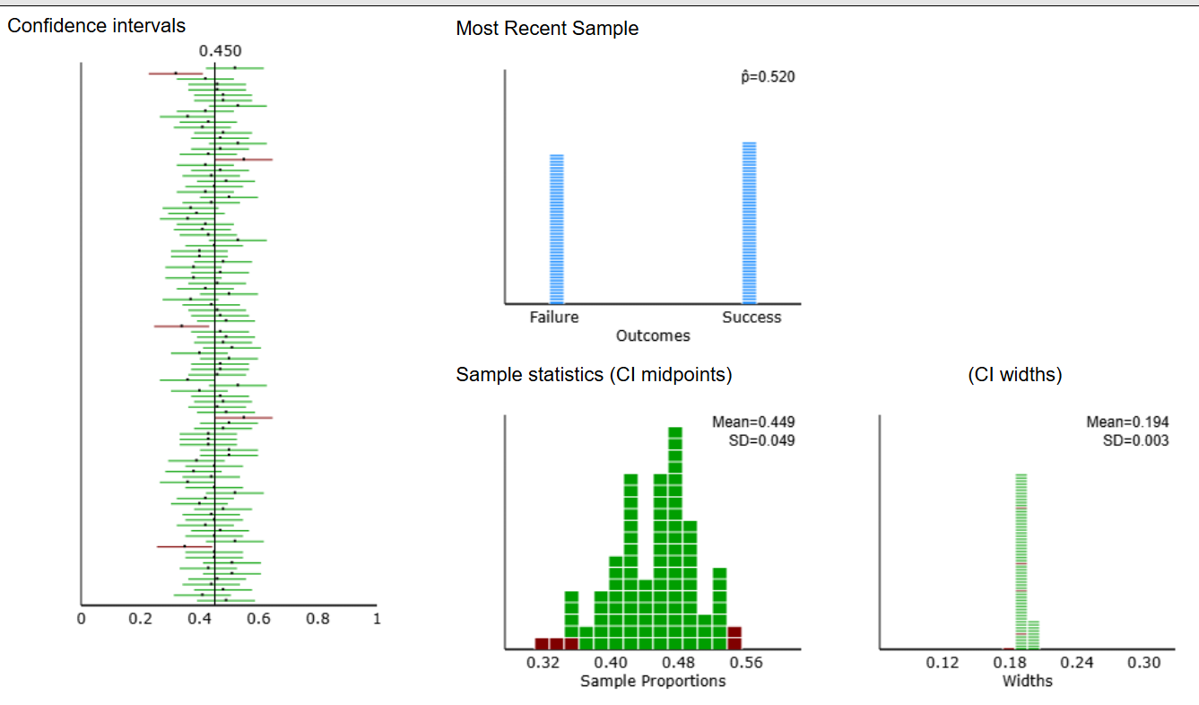

Slide 26
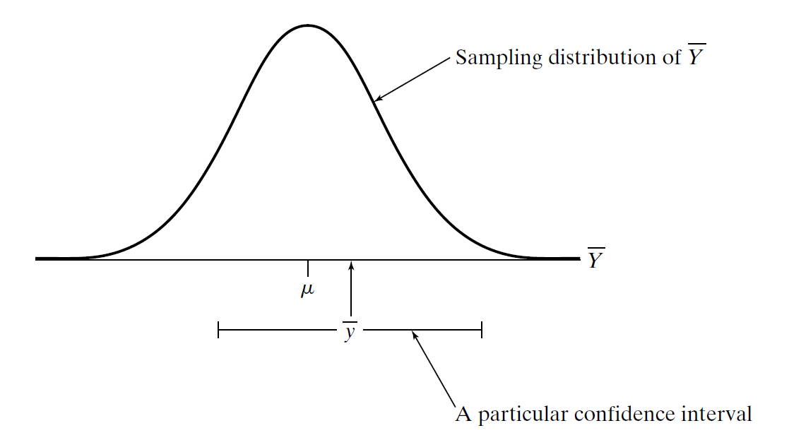
Theoretical Sampling Distribution
$\hat{p}$
$\hat{p}$
$$π$$
$\hat{p}$

